Slide 1
Power & Politics

Slide 2
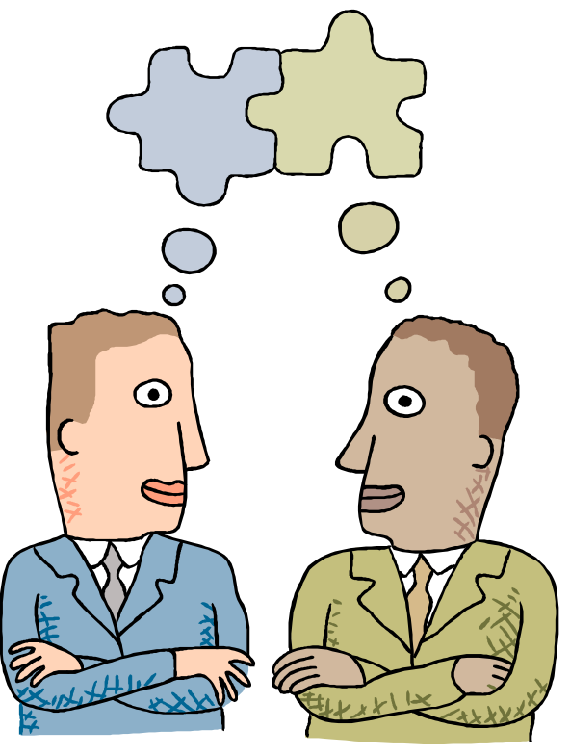
A Definition of Power
Power
A capacity that A has to influence the behavior of B so that B acts in accordance with A’s wishes.
B
A
Power may exist but may not be used
Power is a function of dependency
The greater B’s dependence on A, the greater the power A has over B
Notes:
Power corrupts. Absolute power, corrupts absolutely

Slide 3
What creates dependency?
Importance: The things you control must be important to others
Scarcity: What you’ve got is scarce :
law of demand vrs supply
Non-substitutability: When A/B has become indispensable
B
A
Notes:
Power corrupts. Absolute power, corrupts absolutely

Slide 4

Where does power come from?
Formal Power
Based on an individual’s position in an organization; conveys the ability to coerce or reward, because of formal authority.
Coercive Power
A power base dependent on fear.
Reward Power
Compliance achieved based on the ability to distribute rewards that others view as valuable

Slide 5
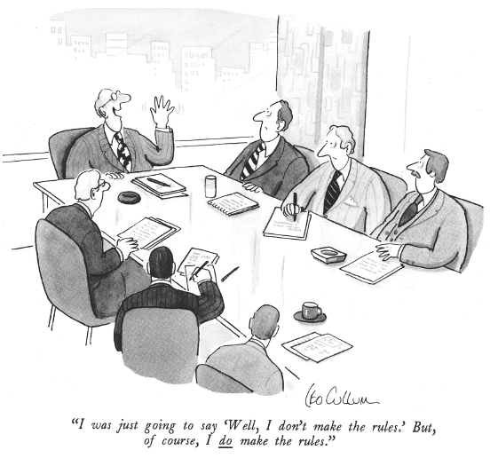
Bases of Power: Formal Power
Legitimate Power
The power a person receives as a result of his or her position in the formal hierarchy of an organization.
Legitimate power includes acceptance by members of the authority of the position

Slide 6
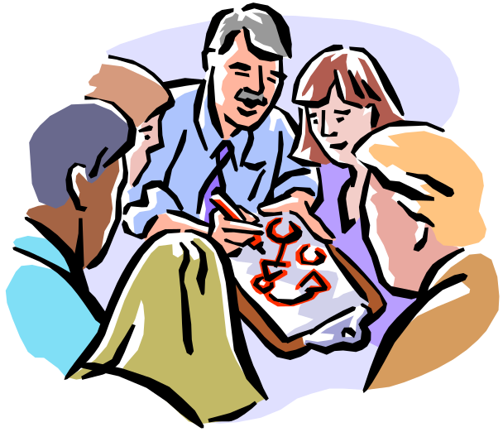
Bases of Power: Personal Power
Power that comes from an individual’s unique characteristics… it may not be formal
Expert Power
Influence based on special skills or knowledge.
Referent Power
Influence based on possession by an individual of desirable resources or personal traits.
Charisma, likeability, emotional effect

Slide 7
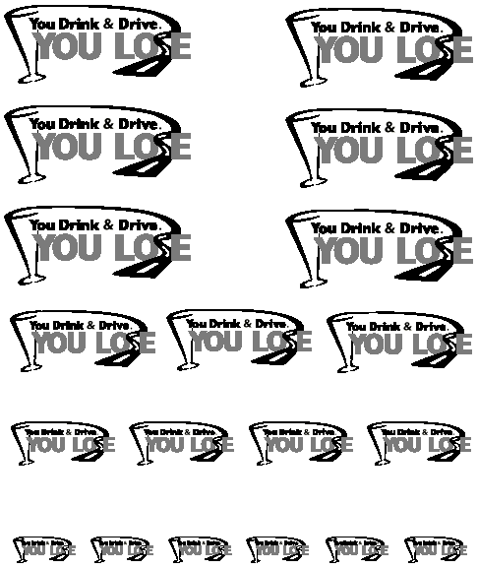

Which Base of Power?
You Drink and Drive… You Lose!
  You can lose your license, time from your job, and lose money in fines and court costs. If you are involved in an accident while impaired, you could face imprisonment for vehicular manslaughter or homicide.

Slide 8

Which Base of Power?

Slide 9

Which Base of Power?
“Four out of five dentists recommend sugarless gum for their patients who chew gum."

Slide 10
Which Base of Power is more effective?
Research reveals that personal power is most effective.
Reward and legitimate appear to be unrelated to job satisfaction, commitment, performance
Coercive can actually backfire

Slide 11
Consequences of Power
Sources of Power
Consequences of Power
Expert
Power
Commitment
Referent
Power
Legitimate Power
Compliance
Reward
Power
Resistance
Coercive
Power

Slide 12
Power Tactics
Ways/ means by which individuals translate power bases into specific actions.
Influence Tactics:
Legitimacy
  Relying on authority/position or simply communicating that it is in accordance with organisational goals
Rational persuasion
  Presenting logic and facts to show that it is reasonable
Inspirational appeals
  Developing emotional commitment by appealing to the target’s hopes, needs, aspirations

Slide 13
Power Tactics
Consultation
  Involving X in the decision which increases X’s motivation
Exchange
  Rewarding X with benefits/favours for following request
Personal appeals
  Compliance based on friendship or loyalty

Slide 14
Power Tactics
Ingratiation
  Using flattery, praise or friendly behaviour
Pressure
  Using warnings, demands, threats
Coalitions
  Using support of others to get target to accede/ agree
  (strength in numbers)‏

Slide 15
Power tactics that work better depending on the direction of influence
Upward Influence Downward Influence Lateral Influence
Rational persuasion Rational persuasion Rational persuasion
Inspirational appeals Consultation
Pressure Ingratiation
Consultation Exchange
Ingratiation Legitimacy
Exchange Personal appeals
Legitimacy Coalitions

Slide 16
Other influences on power
The cultures within organisations where X works will also help determine what tactic will be most effective:
  warm, relaxed, supportive : formal and conservative
Cross cultural differences (reason vrs coalitions)‏
Gender differences

Slide 17
Politics: power in action
When employees in organisation convert their power in to action, we say they are engaged in politics
Political behaviour – activities that are outside of one’s formal role in the organisation, that influences or attempt to influence the distribution of advantages or disadvantages within the organisation

Slide 18
Politics is in the eye of the beholder
"Political" Label
"Effective Management" Label
Blaming others
vrs
Fixing responsibility
"Kissing Up"
vrs
Developing work relationships
Apple polishing
vrs
Demonstrating loyalty
Passing the busk
vrs
Delegating authority
Covering your rear
vrs
Documenting decisions
Forming coalition
vrs
Facilitating teamwork
Scheming
vrs
Planning ahead
Overachieving
vrs
Competent and capable
Ambitious
vrs
Career minded
Cunning
vrs
Practical minded
Arrogant
vrs
Confident

Slide 19
Factors contributing to political behaviour
Individual factors:
  High self monitors
  Internal locus of control
  High Mach personality
  Organisational investment
  Perceived job alternatives, posess scarce skills/knowledge, influential contacts outside, great reputation
  Expectations of success

Slide 20
Factors contributing to political behaviour
Organisational factors : certain cultures and environments seem to support/ promote politics
  Reallocation of limited resources
  Promotion opportunities
  Low trust
  Role ambiguity
  Unclear performance evaluation system
  Zero-sum reward practice (I win - You lose)‏
  Democratic decision making
  High performance pressures
  Self-serving senior management

Slide 21
How do people respond to politics?
‘Kiss up’ to upper management
Watch out for ‘back stabbers’
Depends also on the culture they come from (in some countries there is a lot of power struggles…such employees accept organisational politics easily)‏
Others resort to defensive behaviour
  Playing dumb, stretching, stalling, misrepresentation of information, scapegoating, buffing, prevention, playing safe, etc..

Slide 22
EMPLOYEES RESPONSES TO ORGANISATIONAL POLITICS
Decreased job satisfaction
Increased anxiety and stress
Organisational politics may threaten employees
Increased turnover
Reduced performance

Slide 23
Types of Political Activity
Attacking or blaming others
Controlling information
Forming coalitions
Networking
Creating obligations
Managing impressions
Notes:
Material pertinent to this discussion is found on pages 278-279.

Slide 24
Impression Management [IM]
The process by which individuals attempt to control the impressions others form of them
Who is most likely to do IM?
  High self monitors

Slide 25
Impression management techniques:
Conformity
  Agreeing with someone else in order to gain his/her approval
Excuses
  Explanation of an event aimed at minimising the severity of it
Self promotion
  Highlighting one’s quality, downplaying one’s deficits, calling attention to one’s achievements

Slide 26
Impression management techniques:
Flattery
  Complimenting others about their virtues in order to make one appear as perceptive and likeable
Favours
  Do something nice for someone to gain that person’s approval
Association
  Enhancing one’s image by managing information about people and things with which one is associated

